Slide 1

ProctorNow
Online Examination System
Review-02

Slide 2
Team Member
RA2011003011334 RISHABH SINGH SAHIL
RA2011003011346 NIKHIL KAR
RA2011003011341 ABHISHEK VERMA

Slide 3
Abstarct
Online examination systems are becoming increasingly popular as more educational institutions adopt remote learning models. This system provides an effective way for students to take exams securely and conveniently without the need to travel to a physical location. The online examination system is a web-based application that enables students to take tests from any location using a computer, tablet, or mobile device with an internet connection. It has features such as randomizing questions and answers, time limits, and anti-cheating measures to ensure fairness and accuracy. The system also allows instructors to create, manage, and grade exams easily and efficiently. This abstract provides a brief overview of the features and benefits of an online examination system.

Slide 4
Unique Features in Web-Application
User registration and login*: Allow users to register for an account and log in to access the examination system.
Question bank management*: Allow exam administrators to create and manage a question bank, including adding, editing, and deleting questions.
Exam scheduling*: Allow exam administrators to schedule exams and set the date and time for each exam.
Automated grading*: Automatically grade exams and provide users with immediate feedback.

Slide 5
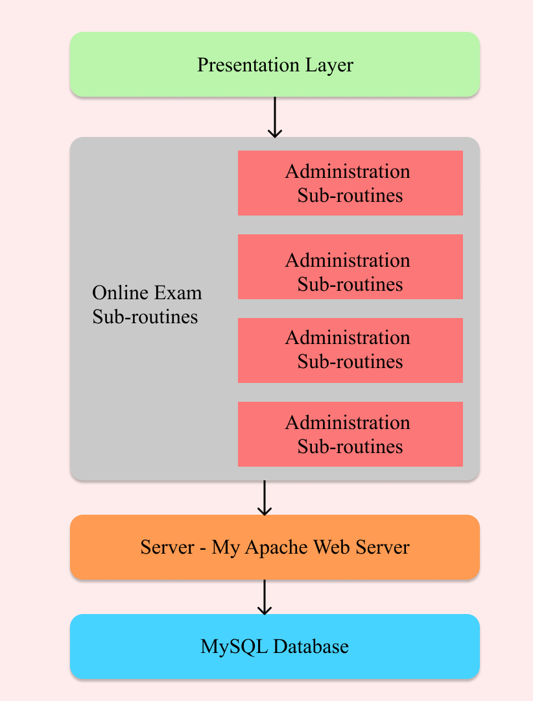
Architecture Diagram

Slide 6
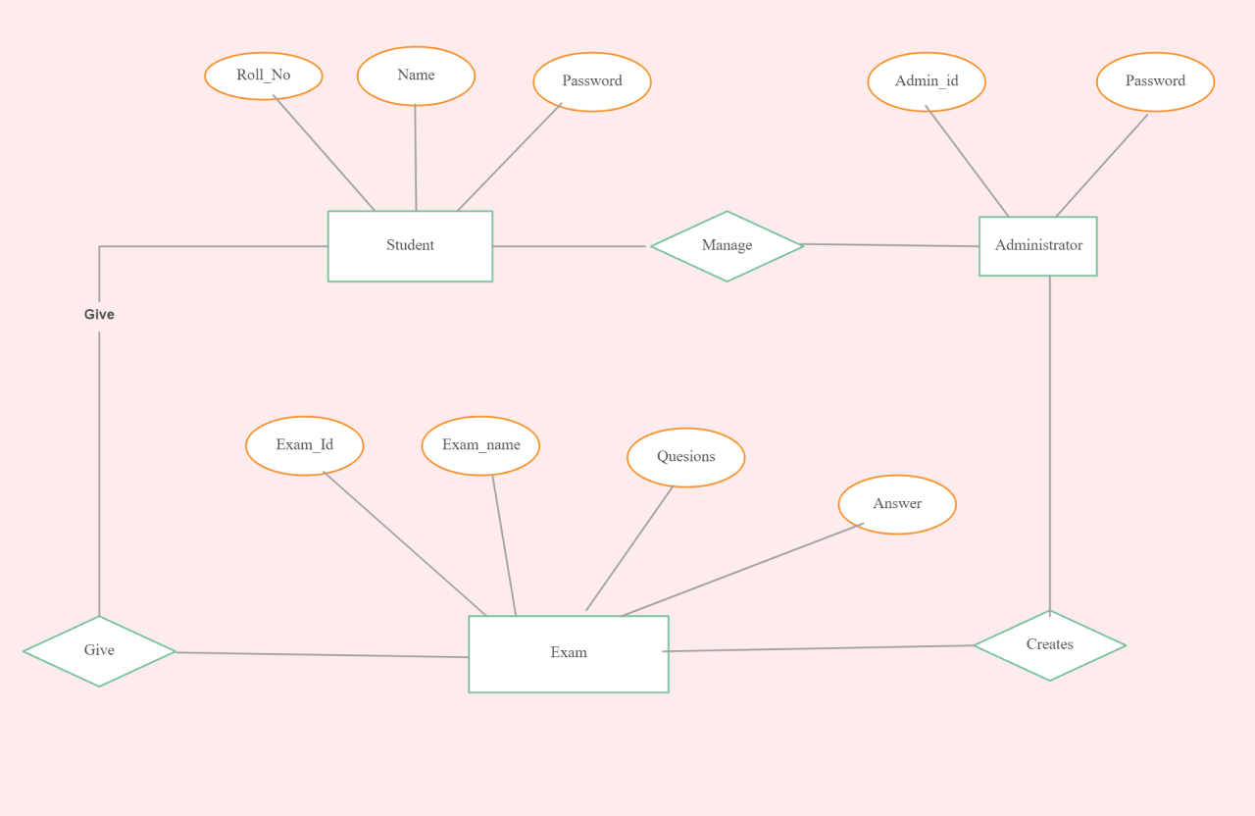
ER Diagram

Slide 7
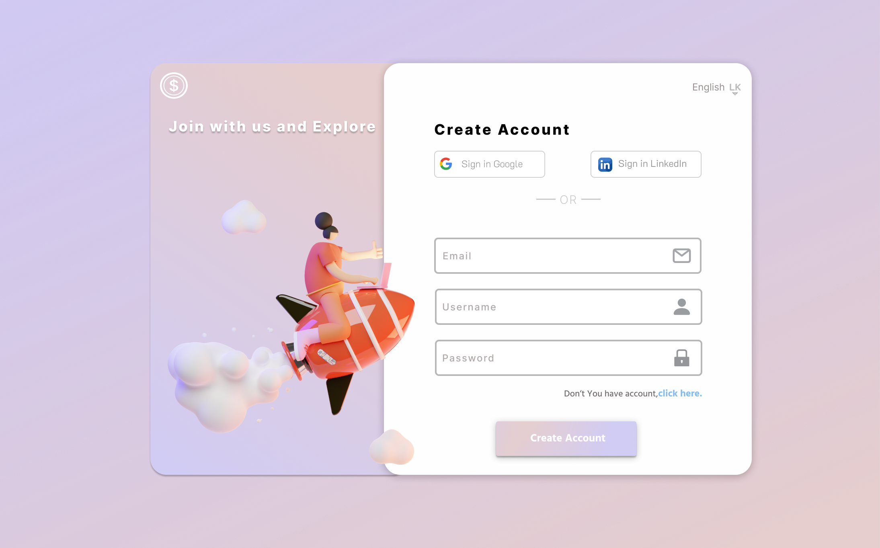
UI for Web-App

Slide 8
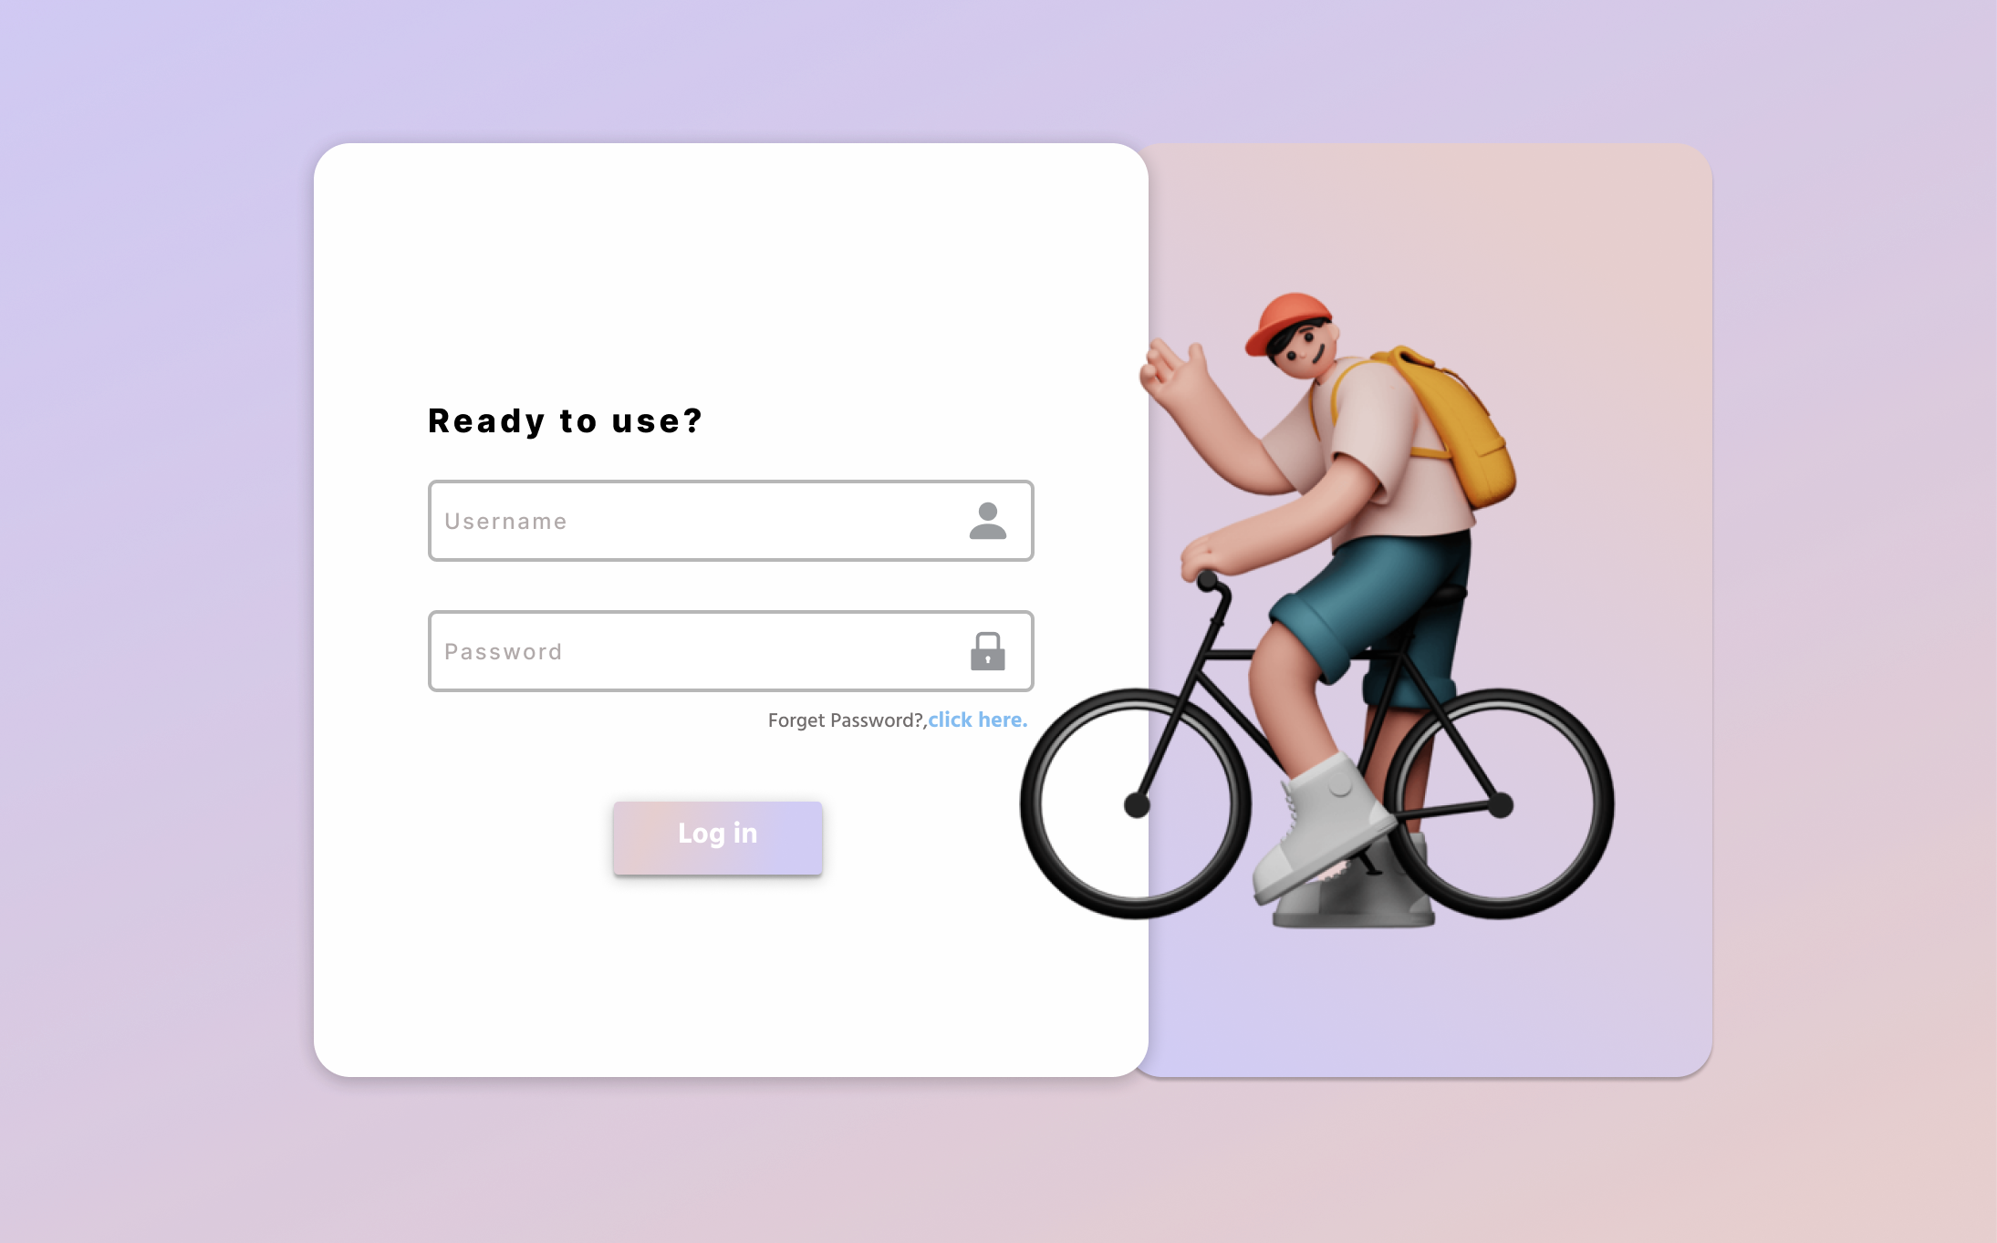
Log In Page

Slide 9

Webiste Logo

Slide 10




Back end (Database) design, software used
Javascript
MySQL
NodeJS
Figma

Slide 11
Refrences
https://www.google.com/
https://www.wikipedia.org/
https://github.com/
https://www.w3schools.com/

Slide 12
THANK YOU

